Slide 1


Analyzing the Impact of Car Features on Price and Profitability
By sarfaraz ahmed mulla

Slide 2
Project description
The rapid growth in automotive industry over the past few decades, with a focus on fuel efficiency, environmental sustainability and technological innovation. With increasing competition among manufacturers and a changing consumer , it has become more important than ever to understand the factors that drive consumer demand for cars.
The project aims to answer which car features are important to be taken under consideration for selecting particular make or model .
Data cleaning : few rows which had blank entry where deleted from data set so that it does not affect our analysis
Data sources : make , model , year , engine fuel type , engine hp , engine cylinders , transmission type , driven wheels , number of doors , market category , vehicle size , vehicle style , highway mpg , city mpg , popularity , msrp were the columns used for analysis

Slide 3
Approach
Data cleaning :
cleaning the data.
Formatting the data to the suited data type for ease for analysis .
Data analysis :
Analyze the dataset .
pivot tables were used for understanding the relationship between different features and summarizing the data .
Calculations were done to get the exact numbers .
Building dashboard
Power bi was used to create dashboard with column charts , scatter plots for informative dashboard
Filters and slicers were added to dashboard
Report
Compiling the data analysis and dashboard results making a detailed report

Slide 4



Tech stack used
Microsoft excel 2016
For cleaning and insight analysis
01
Microsoft power BI
For creating dashboard
02
Power point presentation 2016
For creating the PPT
03

Slide 5
Insights
price based on engine power ?
Engine horse power and car price have direct relationship increase in the horse power will increase average price of model
Hp 55 vs avg msrp 2000 and Hp 1001 vs avg msrp 1757224 As you can see average msrp increses with increase in hp
popularity of a market category?
Flex fuel cars are the most popular with total popularity of 1933488 followed by crossover with total popularity of 1686521.
luxury, luxury and performance, performance have relatively lower popularity but they have significant number of models in market
CAR FEATURES WHICH DETERMINE THE PRICE OF THE CAR ?
REGRESSION ANALYSIS DONE TO FIND WHICH FEATURES AFFECT THE CAR PRICE AND FOLLOWING DATA IS USED FOR REGRESSION ANALYSIS “ENGINE FULE TYPE , Engine HP , Engine Cylinders , TRANSMISSION TYPE , DRIVEN WHEELS , NUMBER OF DOORS , MARKET CATEGORY , VEHICAL SIZE , VEHICAL STYLE , HIGHWAY MPG ,CITY MPG ”
FROM REGRESSION ANALYSIS I HAVE FOUND ENIGNE FULE TYPE AND ENGINE HP ARE 2 FACTORS WHICH AFFECT THE MOST WHEN BUYING NEW CAR

Slide 6
average price of a car vary across different manufacturers?
USING PIVOT TABLE AVERAGE PRICE OF EACH MANUFACTURER
BUGATTI , MAYBACH , ROLLS ROYES HAVE THE HIGHEST AVERAGE .
PLYMOUTH , OLDMOBILE , SUZUKI HAVE LOWEST AVERAGE .
fuel efficiency and the number of cylinders in a car's engine?
INCERESE IN THE NUMBER OF CYLINDERS IN A CAR REDUCES THE HIGHWAY MPG SIGNIFICANTLY.
LESS NUMBER OF CYLINDERS IN A CAR INCRESES THE HIGHWAY MPG SIGNIFICANTLY.
CORRELATION BETWEEN CYLINDERS AND FUEL EFFICIENCY .

Slide 7
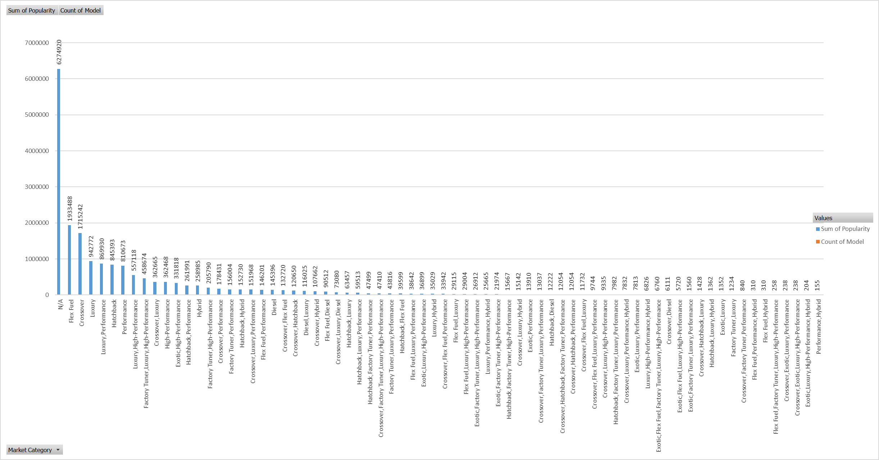
RESULTS
INSIGHT 1
How does the popularity of a car model vary across different market categories?
THE FOLLOWING ANALYSIS WAS DONE USING PIVOT TABLE WHERE SUM OF POPULARITY OF EACH MARKET CATEGORY IS CALCULATED AND MATCHHD WITH MARKET CATEGORY IN USING COUNT OF CAR MODEL IN EACH CATEGORY

Slide 8
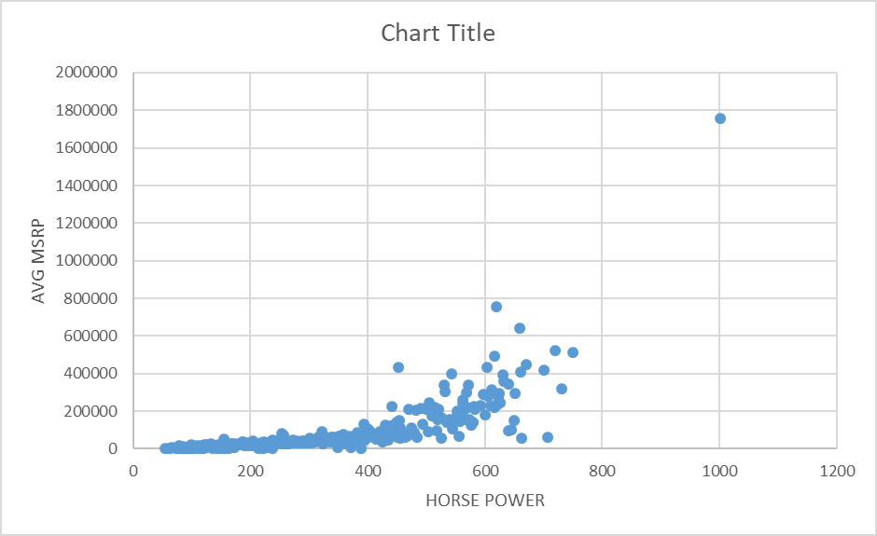
INSIGHT 2 What is the relationship between a car's engine power and its price?
THE FOLLOWING ANALYSIS WAS DONE USING PIVOT TABLE WHERE AVERAGE MSRP OF EACH COMPANY IS CALCULATED AND MATCHHED WITH HORSE POWER

Slide 9
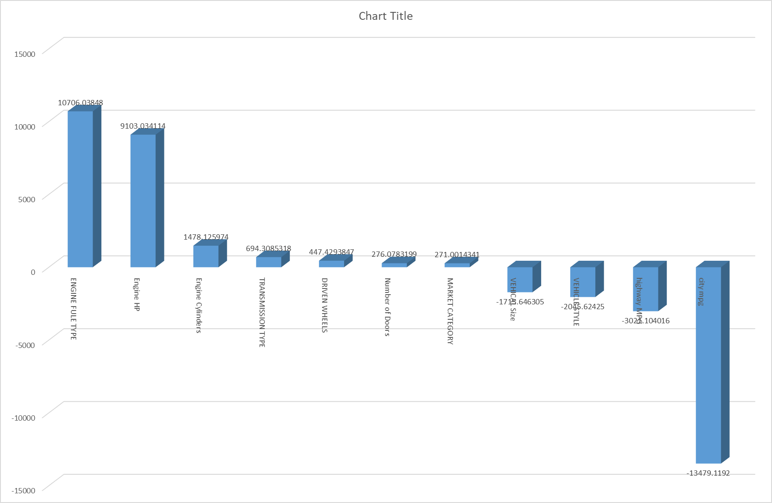
INSIGHT 3 Which car features are most important in determining a car's price?
DATA IS GATHERED AND NON NUMERICAL DATA IS CONVERTED TO NUERICAL DATA USING VLOOKUP FUNTION
USING DATA ANALYSIS FUNTION ON EXCEL PERFORM REGRESSION ANALYSIS ON THE DIFFERENT FEATUERS TO FIND THE IMPORTANT FEATURES

Slide 10
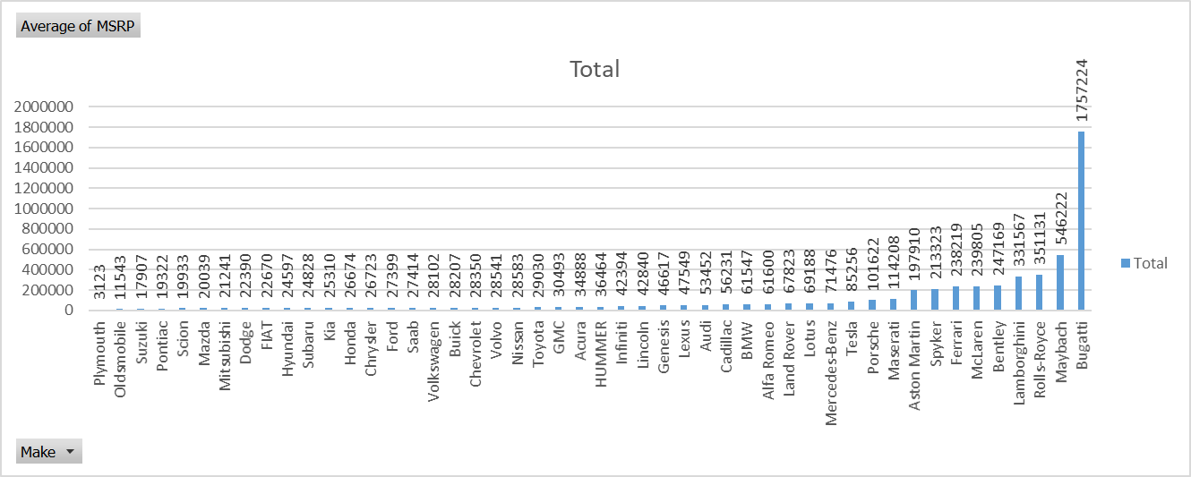
INSIGHT 4 How does the average price of a car vary across different manufacturers?
Using pivot table average of each make is calculated

Slide 11
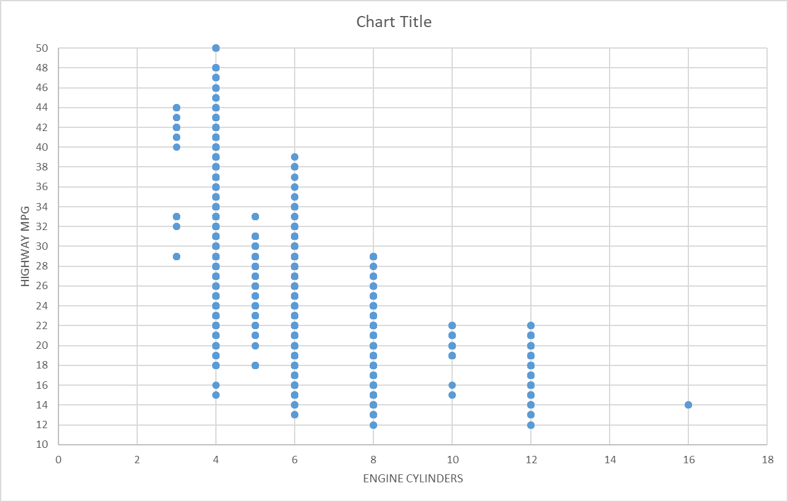
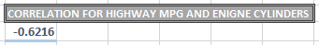
Insights 5 What is the relationship between fuel efficiency and the number of cylinders in a car's engine?
For scatter plot x axis is engine cylinders and y axis highway mpg .
Engine cylinders vs highway mpg
increase in cylinders reduces the mileage
Correlation is calculated using correl formula

Slide 12
Creating dashboard questions to be answered ?
Task 1: How does the distribution of car prices vary by brand and body style?
Task 2: Which car brands have the highest and lowest average MSRPs, and how does this
vary by body style?
Task 3: How do the different feature such as transmission type affect the MSRP, and how does
this vary by body style?
Task 4: How does the fuel efficiency of cars vary across different body styles and model
years?
Task 5: How does the car's horsepower, MPG, and price vary across different Brands?

Slide 13
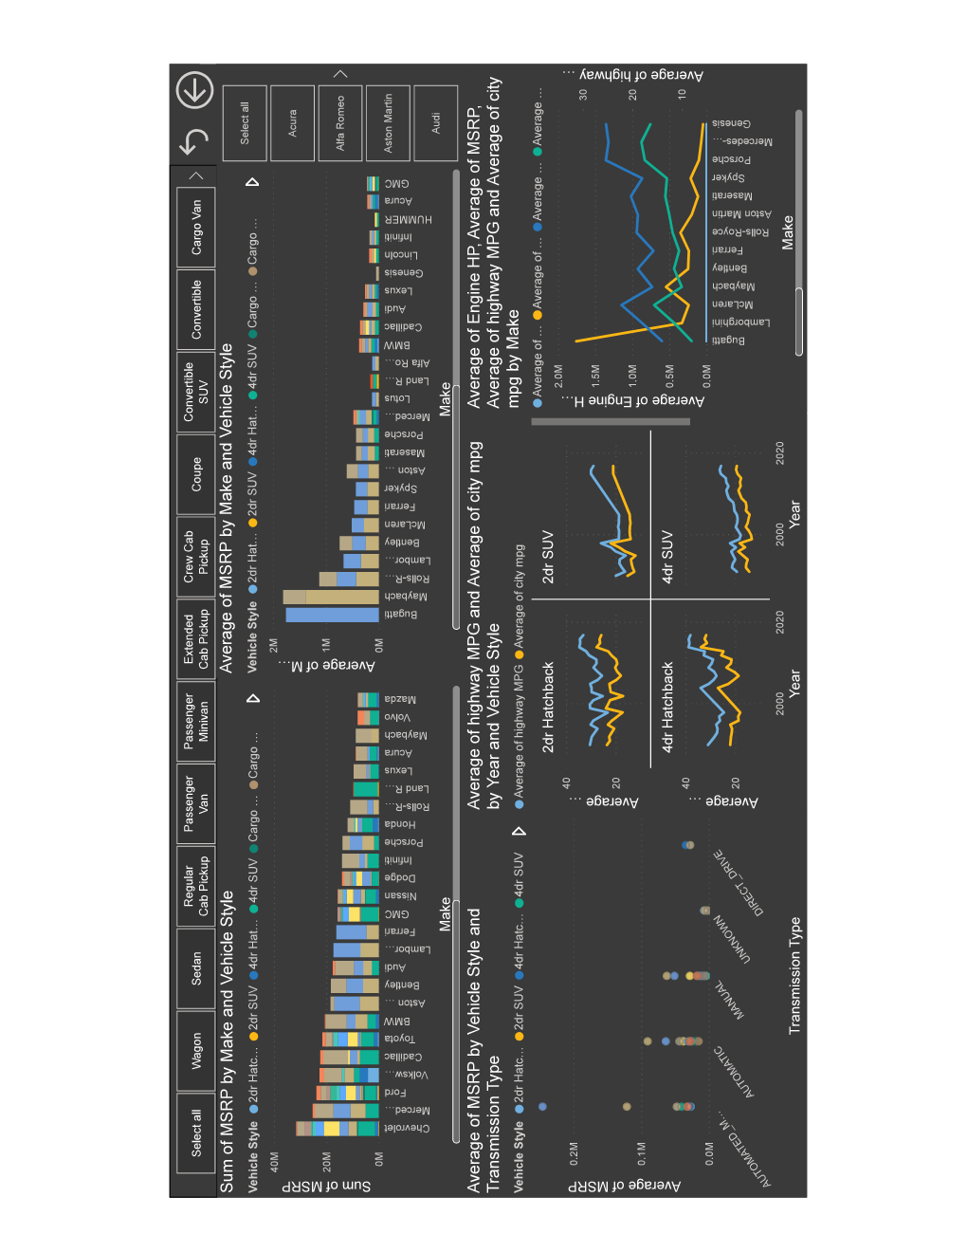
Dashboard

Slide 14
Conclusion
THE ANALYSIS SHOWS HOW CAR PRICE IS AFFECTED BY DIFFERENT FEATURES , DIFFERENT BODY STYLE AND DIFFERENT MARKET CATEGORY
MSRP OF A CAR IS DEPENDENT ON FOLLOWING FACTORS : 1. BODY STYLE
2. MARKET CATEGORY
3. ENGINE HP
MILEGE OF A CAR IS DEPENDENT ON FOLLOWING FACTORS : 1. ENIGNE HP
2. ENGINE CYLINDERS
3. BODY STYLE
AVERAGE PRICE OF A MAKE DEPENDS ON FOLLOWING FACTORS : 1. BODY STYLE
2. NUMBER OF MODELS THEY SELL
3. MILEAGE ON HIGHWAY AND CITY

Slide 15
Hyper link to analysis
https://docs.google.com/spreadsheets/d/1WBAhFIP_uC-5NIH4pLDaBzmCWQmGbv3B/edit?usp=sharing&ouid=112349825885166255529&rtpof=true&sd=true -

